Slide 1
Fundamental Analysis of
Urban Walkability
by ML Modeling
Anh Nguyen, Elizabeth Pacious, Hanna Song.

Slide 2



The team
Anh Nguyen
Elizabeth Pacious
Hanna Song

Slide 3

Table of Contents:
Context and Background
Data Source
Data Preprocessing
Exploratory Data Analysis
ML Modeling

Slide 4

Why walkability?
Measure of how friendly an area is to walk
Importance of quality of life of citizens
Rediscover economic, environmental, and social benefits
Reduce traffic and carbon emissions

Slide 5

Data Source
US Environmental Protection Agency
Smart Location Database Jan 2022

Slide 6
Data Source
About the dataset:
File Format: CSV
Size: 192.2 MB
117 columns and 167265 rows
Dtypes: float 64, int 64, object 2

Slide 7
Data Preprocessing
Before creating a ML model for walkability, the data need preprocessing

Slide 8
How does the Data Preprocessing work?
Step 3
Step 2
Step 1
Select columns that are needed for modeling
Drop nulls
Drop unrelated columns

Slide 9
Exploratory Data Analysis
Identifies general patterns in the walkability data and some data visualizations

Slide 10
How to prepare for modeling
Before modeling our dataset, we transformed walkability index into log for normality
Depending on how columns are related with independent variable of walkability index, we decide to select certain columns

Slide 11
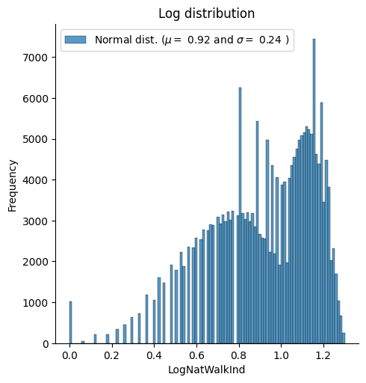
Log Distribution Plot of Log of Walkability Index

Slide 12
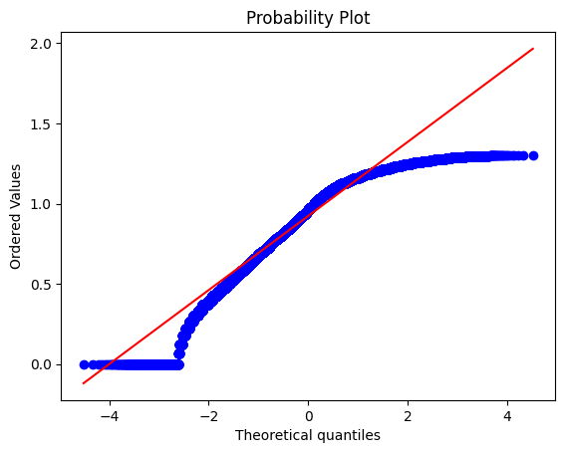
Log Probability Plot of Log of Walkability Index

Slide 13
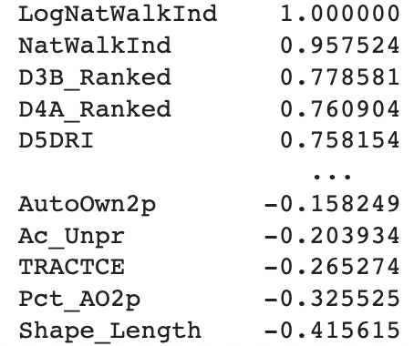
Correlation of All Columns and
Log of Walkability Index
Decide to use top three highly correlated columns from Correlation
Notes:
First regression -> didnt work Highest correlated columns using PCA principal component analysis for ml model

Slide 14
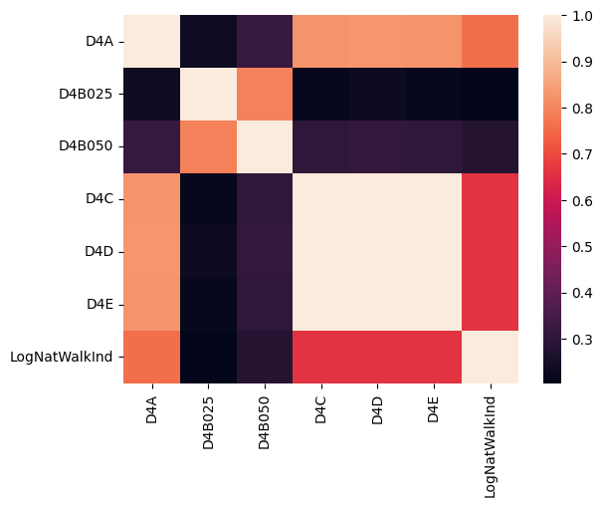
Correlation Heatmap of
Transit Columns and Log of Walkability Index

Slide 15
ML Modeling
Our modeling structured into three sections:
All of the columns
Transit columns
High correlated columns

Slide 16
All data vs log of walkability
Mean Square Error: 496.38
R-squared: 0.25
Notes:
MSE- too high , not good R2: 25 percent of the variance has been accounted, and there might be a couple of issues with methodology

Slide 17
All data vs log of walkability
PCA explained variance ratio: [0.34, 0.25]
PCA singular values: 605.05, 515.35
Notes:
Pca explained variance ratio is .34 and .25 which seems a bad modeling so we will move on to next analysis

Slide 18
Transit columns vs Log of Walkability
Mean Square Error: 0
R-squared: 1
Notes:
MSE: seems good the model has no error , r squared : regression perfectly fit the data

Slide 19
Transit columns vs Log of Walkability
PCA explained variance ratio: [0.15, 0.098]
PCA singular values: 1542.48, 1233.72
Notes:
Transit columns have worse pca modeling result which is .15 and 0.098

Slide 20
High correlation columns vs Log of Walkability
Mean Square Error: 29.96
R-squared: 0.96
Notes:
Mse: better than all the columns,
R squared - good

Slide 21
High correlation columns vs Log of Walkability
PCA explained variance ratio: [0.80, 0.15]
PCA singular values: 753.11, 325.82
Notes:
Naive Bayes Model: 1.50 %
With the high correlation columns, it is

Slide 22
Conclusion and Limitations
Dataset contains various dependent variables that might be unrelated to each other which made our results have low accuracy of walkability index
Using Dimensionality Reduction by correlation and PCA for the modeling give a higher accuracy for the model
PCA resulted in the highest scores because multicollinearity from high correlation between independent variable and dependent variables

Slide 23

Thank You!

Slide 24
Craythorn, W. (2021). Idaho Walkability Index 7/3/2021 [Data set]. Kaggle. https://www.kaggle.com/datasets/whitneycraythorn/idaho-walkability-index-732021
Kerneler, C. (n.d.). Starter: Big City Land Values and (031d5da8-9) [Code]. Kaggle. https://www.kaggle.com/code/kerneler/starter-big-city-land-values-and-031d5da8-9
Mizrahi, R. (2021). How I Ranked 5th/160 in Deloitte's ML Competition [Code]. Kaggle. https://www.kaggle.com/code/rudymizrahi/how-i-ranked-5th-160-in-deloitte-s-ml-competition
Ozkaramanli, H., & Karakaya, M. (2020). Better urban walkability: Using ML to redistribute parking capacity in digital blue foam. Digital Blue Foam. https://medium.com/digital-blue-foam/better-urban-walkability-using-ml-to-redistribute-parking-capacity-in-digital-blue-foam-d76212970282
United States Environmental Protection Agency. (n.d.). EDGE Metadata Catalog: Smart Location Mapping [Data set]. Environmental Data Gateway. https://edg.epa.gov/metadata/catalog/search/resource/details.page?uuid=%7B33514B4C-54F2-464A-BCC7-35F441B7E21A%7D
United States Environmental Protection Agency. (n.d.). Smart Location Mapping. Environmental Protection Agency. https://www.epa.gov/smartgrowth/smart-location-mapping
Yu, H., Wang, Y., Wang, X., & Wu, J. (2020). Prediction of walkability using machine learning techniques: A case study in Beijing. Sustainable Cities and Society, 65, 102589. https://doi.org/10.1016/j.scs.2020.102589
Reference

